Slide 1

Cyclists Dashboard Report
Business Task and Analysis
Suraj Kashid (MB25)

Slide 2
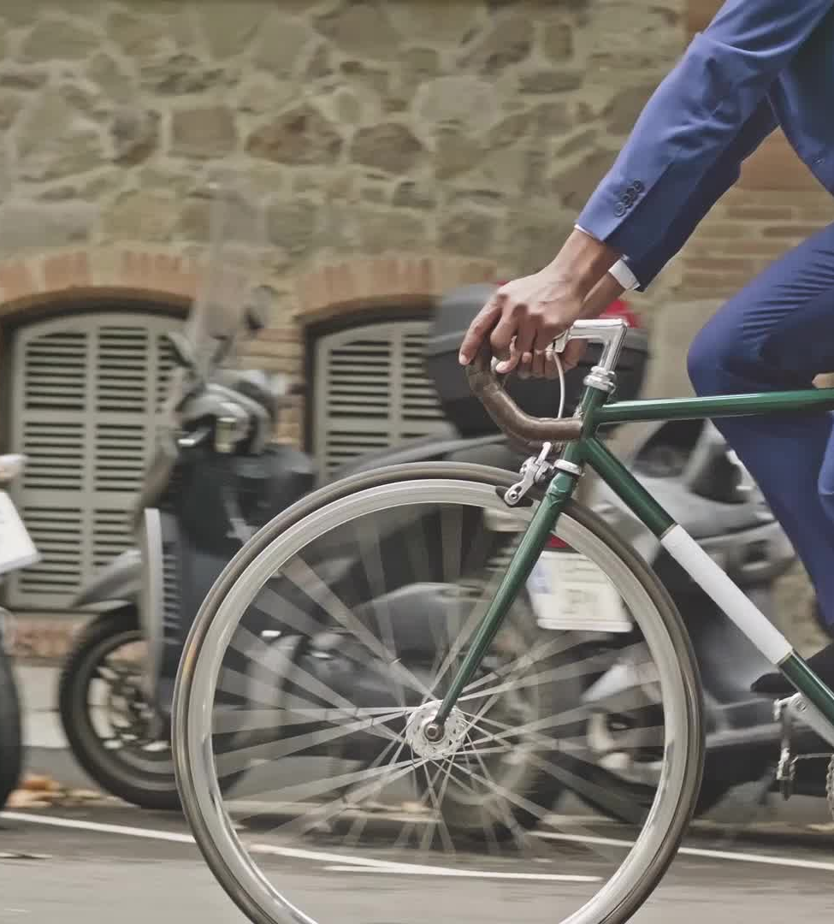
Statement of the Business Task
The primary objective of the Cyclistic bike-share dashboard is to:
Analyze how riders use Cyclistic bikes, focusing on ride frequency, duration, and bike types.
Segment riders into casual riders and annual members based on their ride behavior and membership type.
Provide data-driven insights to support the creation of a marketing strategy aimed at converting casual riders into annual members.

Slide 3
Data Sources Used
Historical Trip Data: This includes data on the frequency and duration of rides, as well as the types of bikes used by both casual riders and annual members.
CSV File - Data Analytics (2): This file contains detailed rider data necessary for the analysis.
Public Data from Motivate International Inc.: Public datasets provided under a specific license, which are used to explore how different customer types utilize Cyclistic bikes.

Slide 4
Data Cleaning and Manipulation
Removed duplicate entries.
Corrected inconsistent date formats.
Merged datasets on common fields like date and location.
Created new measures for Ride Duration.

Slide 5
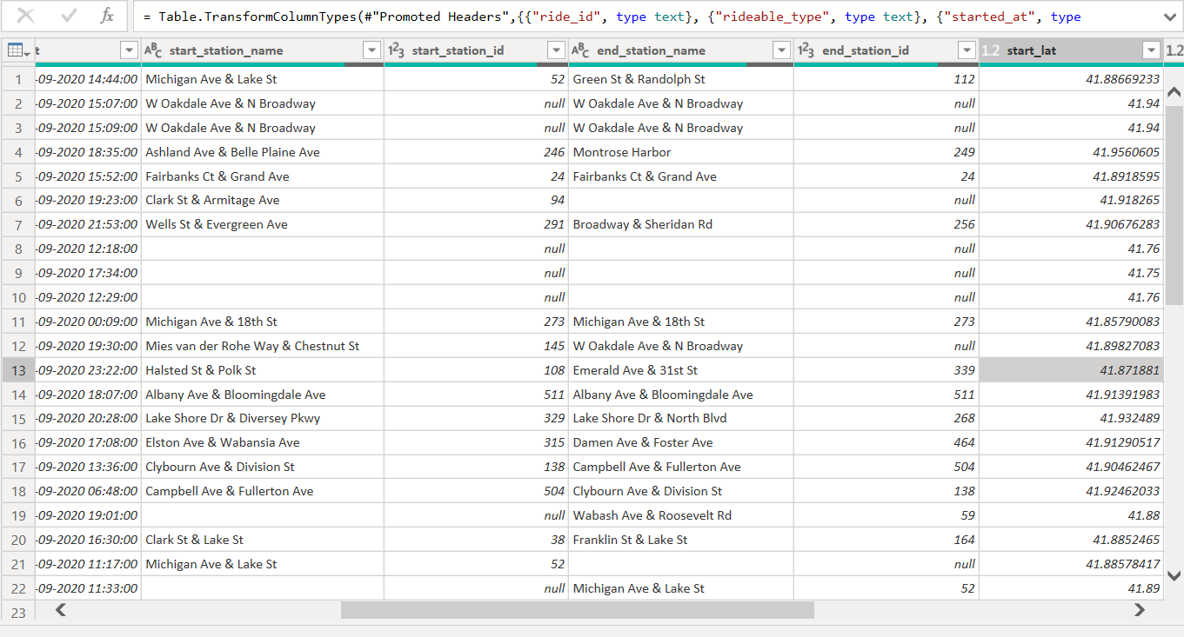

Slide 6
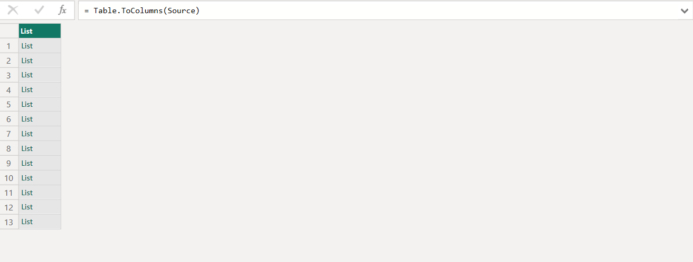
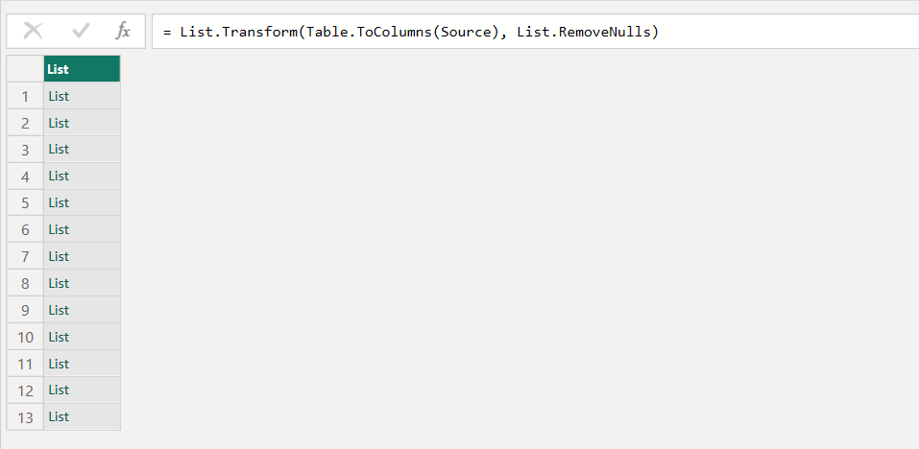

Slide 7
Summary of Analysis
Total Rides: 13M
Average Ride Duration: 25.14
Bike Types Used: Docked And Electric
User Segmentation:
Casual Riders: 97K
Annual Members: 404K
Peak Usage Times:
September’s 1st week
Popular Routes: Central park avenue & Ogden Ave
Impact of Weather: Autum (Very pleasant weather)

Slide 8
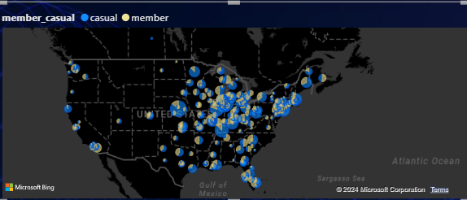
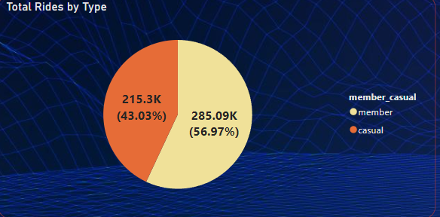
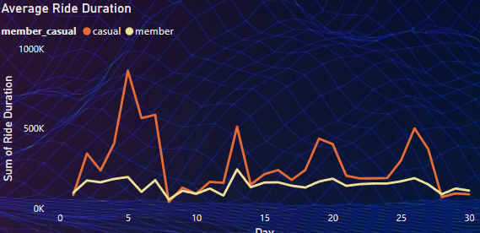

Slide 9


KPI

Slide 10
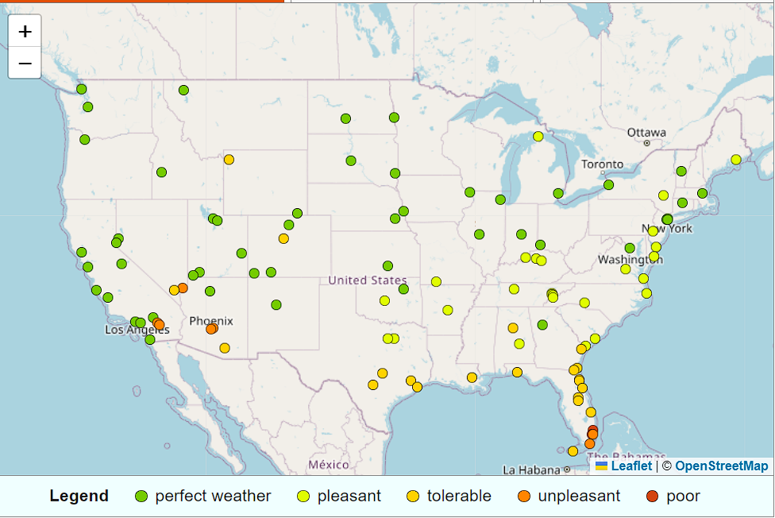
Key Findings
Higher Frequency of Rides Among Annual Members: Annual members exhibit a higher frequency of rides compared to casual riders, indicating consistent usage and engagement with the bike-share program.
Longer Ride Duration for Casual Riders on Weekends: Casual riders tend to have longer ride durations during weekends, suggesting they use the service more for leisure activities.
Peak Usage During Morning and Evening Commutes: Both casual and annual members show increased bike usage during typical commuting hours, highlighting the importance of bike availability during these times.
Preference for Electric Bikes Among Casual Riders: Casual riders show a preference for electric bikes, which could suggest potential marketing strategies to convert them to annual memberships by promoting the benefits of these bikes.
Station Utilization Patterns: Certain bike stations experience higher usage, indicating potential areas for expansion or increased bike availability.
These insights provide a foundation for strategic decisions aimed at enhancing rider experience, improving operational efficiency, and ultimately increasing the number of annual memberships.

Slide 11

Top Three Recommendations
Increase
Increase bike lanes and safety measures on popular routes.
Promote
Promote cycling during favorable weather through community events.
Implement
Implement more covered bike racks to protect against weather.

Slide 12

Conclusion
By understanding cyclist behavior and preferences, the city can improve infrastructure, enhance safety, and promote cycling as a healthy and sustainable mode of transportation.

